Slide 1
Supporting all learners in accessing grade-level mathematics
Core Advocates Monthly Webinar
March 1, 2017
The webinar will begin shortly. You may wish to download the handouts (check the tab on your webinar control panel) while you wait.
Notes:
Handouts:

Slide 2
Introductions
Your hosts from the Field Impact Team
Sandra Alberti, Director
Janelle Fann, Project Manager
Jennie Beltramini, Teacher Engagement Manager
Joanie Funderburk, Manager of Professional Learning
Lynda Nguyen, Team Coordinator
This Month’s Guests
Astrid Fossum, Math Team, SAP
Sara Baranauskas, Connecticut Core Advocate

Slide 3

To learn more about Core Advocates…
Contact Jennie Beltramini (jbeltramini@studentsachieve.net ) or Joanie Funderburk (jfunderburk@studentsachieve.net)
Complete this survey to join our database (and mailing lists): http://bitly.com/joincoreadvocates
Visit our website: www.achievethecore.org

Slide 4

Tweet with us!
Please share your learning by tweeting during and after the webinar using #coreadvocates
@achievethecore
@JoanieFun, @salberti, @JennieBeltro
@AstridFossum
@sarabara13

Slide 5

Webinar protocols
During the webinar
– Accessing Documents
– Questions option
– Polling
After the webinar
– Survey
– Access to recorded webinar

Slide 6
Instructional Advocacy – A Definition
Grounded in a firm understanding of the Shifts, educators owning, supporting, and promoting the resources, tools, and practices that create learning environments in which students develop college- and career- readiness.

Slide 7
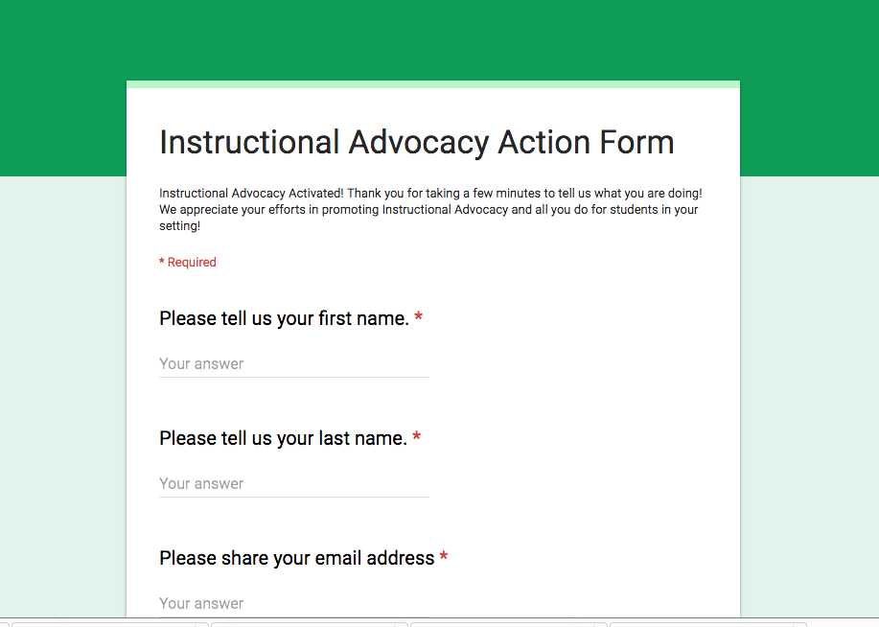
Tell us about your successes
www.achievethecore.org/educators-taking-action

Slide 8
Goals of the webinar
Understand why it is crucial for ALL students to work with and learn grade-level math content.
Gain strategies for supporting students who struggle to access grade-level math content.
Learn about specific resources for applying strategies to your own classroom.

Slide 9
The Importance of Grade-level Content for ALL

Slide 10
National Council of Teachers of Mathematics
“Opportunity to learn remains one of the best predictors of student learning (NRC, 2001). Differentials in learning outcomes therefore are not a result of inclusion in any demographic group, but rather are significantly a function of disparities in opportunities that different groups of learners have with respect to access to grade-level (or more advanced) curriculum, teacher expectations for students and beliefs about their potential for success, exposure to effective or culturally relevant instructional strategies, and the instructional supports provided for students.”
NCTM Position Paper: Closing the Opportunity Gap; http://www.nctm.org/Standards-and-Positions/Position-Statements/Closing-the-Opportunity-Gap-in-Mathematics-Education/

Slide 11
Research: National Mathematics Advisory Panel
“Success in mathematics education also is important for individual citizens, because it gives them college and career options, and it increases prospects for future income. A strong grounding in high school mathematics through Algebra II or higher correlates powerfully with access to college, graduation from college, and earning in the top quartile of income from employment.”
National Mathematics Advisory Panel, Final Report, p. xiiI
https://www2.ed.gov/about/bdscomm/list/mathpanel/report/final-report.pdf

Slide 12
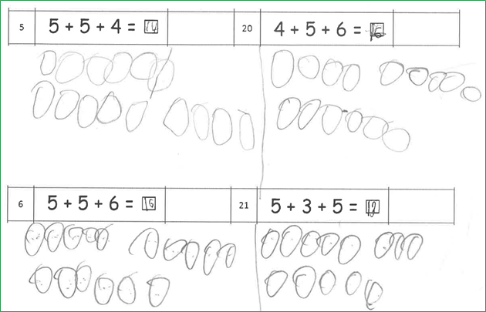
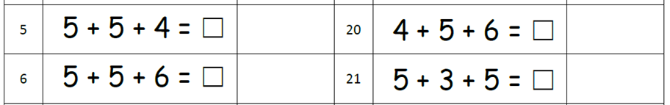
Meet them (but don’t keep them) where they are

Slide 13
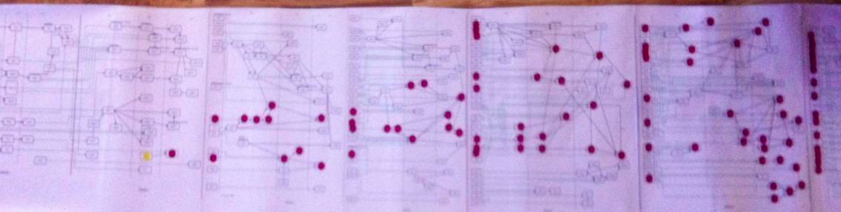
Snowball effect
yellow dot: standard 2.G.2
red dots: standards in grades 3, 4, 5, 6
standards that should be mastered before 7th grade

Slide 14
Question:
What prevents teachers from using grade level materials and instruction with all students? What hesitations do you have about this practice?
Please use the Questions tab on your control panel to respond.

Slide 15
Access for All: Strategies for Supporting ALL Learners

Slide 16
Principles to Actions, Ensuring Mathematical Success for All, NCTM, 2014
Guiding Principle: Access and Equity.
An excellent mathematics program requires that all students have access to a high-quality mathematics curriculum, effective teaching and learning, high expectations, and the support and resources needed to maximize their learning potential.

Slide 17
Strategic Task Selection
Principles to Actions, Ensuring Mathematical Success for All, NCTM, 2014
Mathematics Teaching Practices
Implement tasks that promote reasoning and problem solving.
Effective teaching of mathematics engages students in solving and discussing tasks that promote mathematical reasoning and problem solving and allow multiple entry points and varied solution strategies.
Elicit and use evidence of student thinking.
Effective teaching of mathematics uses evidence of student thinking to assess progress toward mathematical understanding and to adjust instruction continually in ways that support and extend learning.

Slide 18
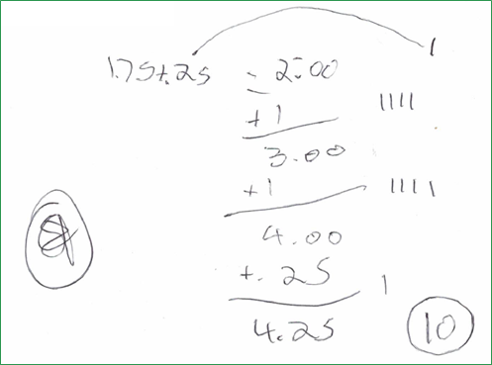
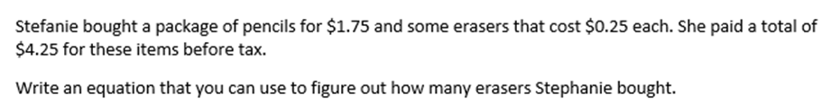
Looking at Student Work: 7th Grade Task
Notes:
Let’s take a few minutes to review and ponder the task shown here.
Now look at the evidence the student has provided, this time in writing.
What’s going on here? Student has procedural understanding and was able to decode the application situation. Is there a piece of conceptual understanding that is missing since there is no equation? Would this child need small group intervention or is this something the teacher can check for during whole group instruction?
Given this information, there are decisions to make. Do I have enough information from other sources to know the needs of the students? Do I need to follow up by asking some questions? Would written descriptive feedback and an opportunity to revise/complete work be enough?
It sounds like a lot of possible paths to consider. There are, and optimistically let's celebrate that the student evidence allows the teacher to consider instructional decisions and meeting the needs of the learner. Other tasks would not illuminate the considerations to make when thinking about how to support this learner.

Slide 19
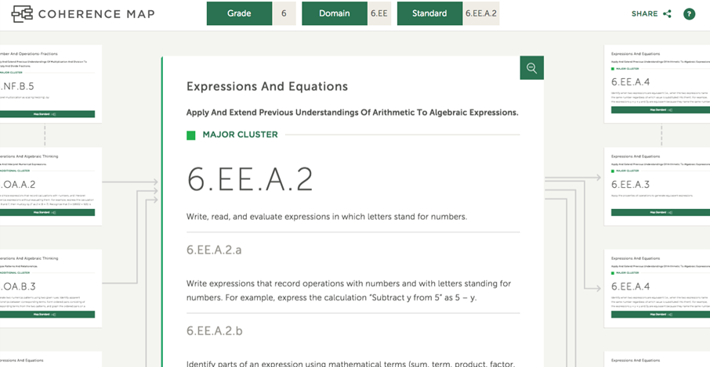
Coherence Map
www.achievethecore.org/coherence-map
Notes:
So, where do I go when I have given tasks and need a little more guidance about possible student misunderstandings?
One tool that can support your work, especially as you think about tracing back to prerequisite knowledge, is the Coherence Map.
This resource allows you to dig into a standard and some additional resources. When you select a standard in the Coherence Map, it may be one that you are working on, planning for, or where you have observed students struggling or grappling with misunderstandings. Say I’m clicking in to grade 6 the standard I’ve selected will be my home standard and a path will appear,like the one shown here, where you are shown how the standards connect. These connections could be other standards within the grade, allowing you to build coherence within grade level universal instruction time. Or the connections shown may be outside of the grade level, from prior grades, illustrating how you can strengthen unfinished learning within whole or small group instruction.

Slide 20
Poll:
Which features of the Coherence Map have you used to support struggling learners?

Slide 21
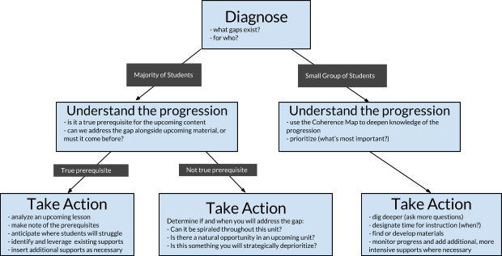
Providing access to grade-level content for all students
Notes:
Co-created with Chrissy Allison, Director, Math Professional Learning at ANet
Process:
Study standards and curriculum to deeply understand grade level expectations and connections between standards:
What is the major work of the grade? How do supporting and additional standards connect to or reinforce the major work?
How do units and lessons build or progress throughout the year?
What are some of the major prerequisite knowledge, skills, and understandings students will need to be successful?
Diagnose students’ current knowledge, skills, and understanding.
What can and can’t they do?
How many? Which students?
Create an action plan to bridge the gap.
How imperative is it for the upcoming content?
Who needs it and when will we do it? (Consider how it fits within MTSS)
Find and plan the instructional activities

Slide 22
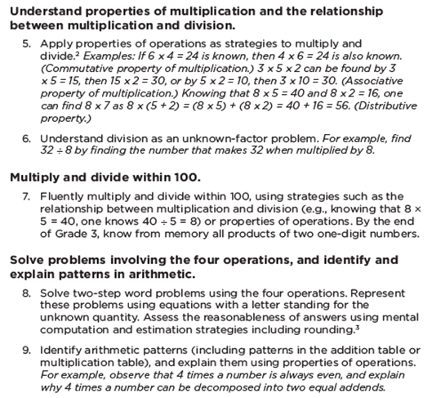
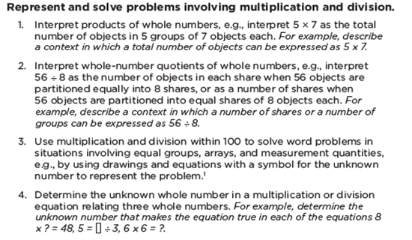

What likely impact does proficiency with 3.OA.C.7 have on the other grade 3.OA standards?

Slide 23
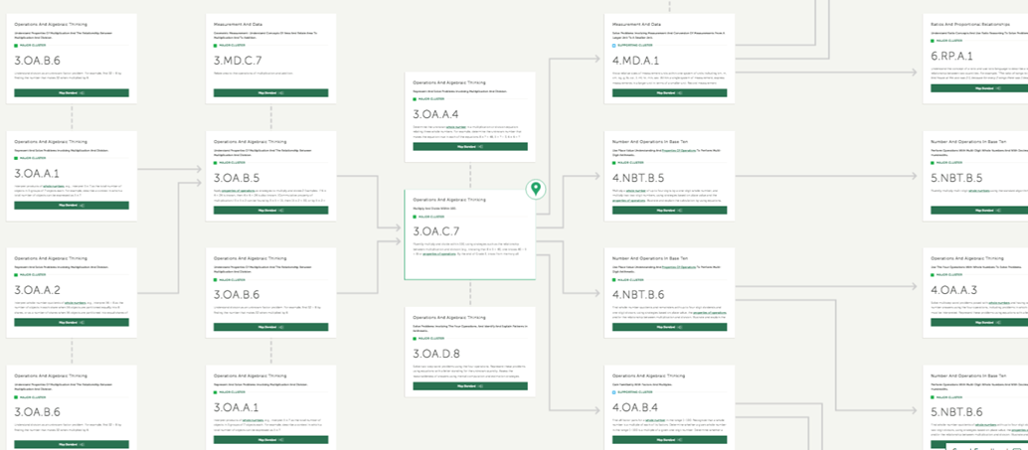
Notes:
On your screen the left half of flowchart was about action steps whole class support.Let’s say the majority of students in the 3rd grade class are struggling to become fluent. We start with the standards. Putting the fluency standard 3.OA.C.7 in the Coherence Map, the teachers gets the following connections, shown on the slide. We see strong connections to work within grade 3 as well as in future grades 4, 5, and 6. As major content of grade 3, we can click on any of these boxes/standards and get additional resources, lessons, tasks, assessment items to supplement instruction. This is information for planning the remainder of the year and supporting fluency.

Slide 24
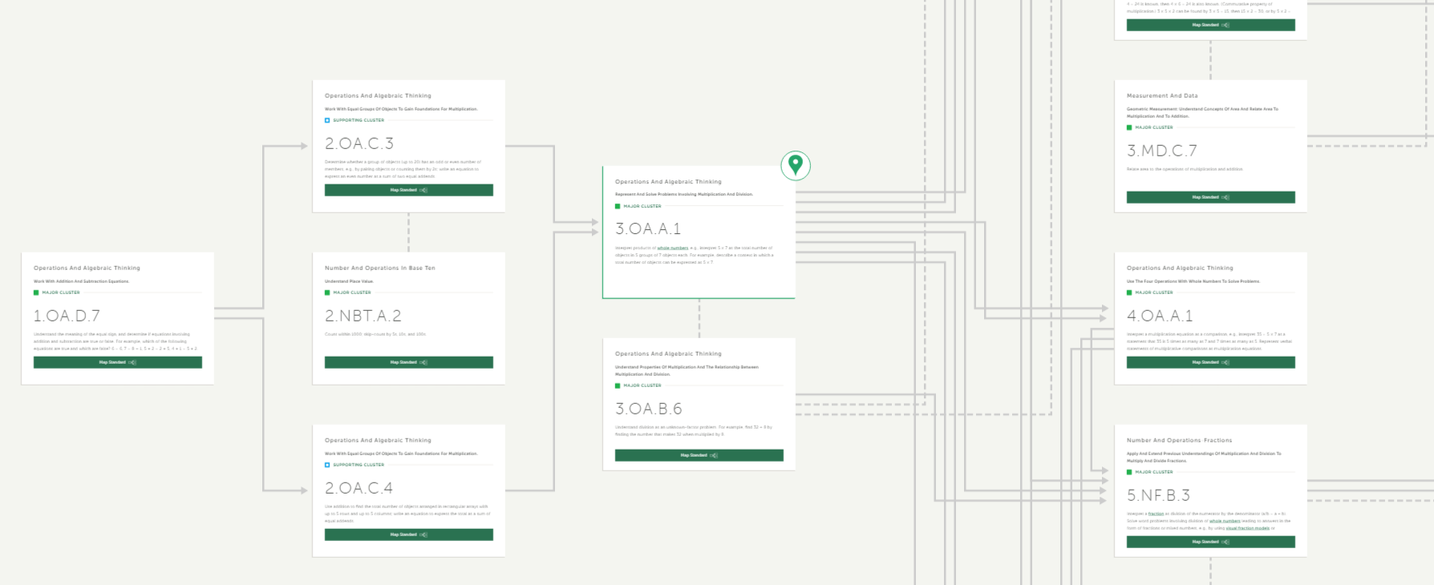
Notes:
The right half of support flow chart, on your screen, from a few slides ago, addresses a smaller number of students still struggling. Using the third grade example from before say that I have been working to incorporate fluency throughout universal instruction. However, there remain students who are not progressing with fluency. As I gather evidence from other tasks, use diagnostic information, I can also use the Coherence Map. Here, I may have pinpointed that the students are struggling to make sense of the meaning of multiplication, 3.OA.A.1. The Coherence Map gives me a path of previous content along with lessons, activities and assessment items that I can use with the small group and support all of the learners.

Slide 25
Common missteps:
Misstep | Recommendation
Trying to address every gap a student has | Prioritize upcoming content and most essential pre-requisite
Trying to build from the ground up or going back too far | Go back just enough to provide access to grade level material
Halting instruction for a broad review | Provide just in time support within each unit or during intervention
Prioritizing supporting/additional clusters even if they appear to be students’ weakest areas | Focus on major work clusters from current or previous grades as it relates to upcoming content
Disconnecting intervention from content students are learning in math class | Connect learning experiences in intervention and universal instruction
Re-teaching students using previously failed methods and strategies | Provide new experiences for students to re-engage, where appropriate
Teaching intervention in only a procedural way | Consider the aspect of rigor called for in the standards when designing and choosing tasks
Notes:
With ANet we have been talking about common missteps and possible recommendations we’ve seen. If you think there are revisions or additions to the list, please reach out.
Talk through these in the context of supporting all learners and being strategic (strategic as a strategy!)

Slide 26
Question:
How does using the Standards to create a strategic approach to intervention set teachers and students up for success?
Please use the Questions tab on your control panel to respond.

Slide 27
Resources for supporting all learners

Slide 28


Guest Core Advocate: Sara Baranauskas
K-5 Math Curriculum Leader
Suffield Public Schools
Connecticut
Photo here

Slide 29
Basic condition of teaching
“... all classrooms exhibit a wide variety of prior learning each day…The natural distribution of prior knowledge in classrooms should not prompt abandoning instruction in grade level content, but should prompt explicit attention to connecting grade level content to content from prior learning. To do this, instruction should reflect the progressions on which the CCSSM are built.”
The Structure is the Standards; http://achievethecore.org/page/845/the-structure-is-the-standards

Slide 30
Supports for Special Education - Areas of demands and difficulties
Conceptual processing
Language
Visual-spatial processing
Organization
Memory
Attention
Notes:
Research in the area of struggling learners in math identifies these six issues as having the greatest impact on learning of mathematics. MA’s Executive Office of Education did work around this research in order to contribute to their implementation of RTI, specifically to increase teacher’s understanding of both mathematics and of the variability of learners in the classroom, enabling them to support educators in meeting the needs of all students. This work focused teachers on conceptual understandings and the mathematical practices that are an essential part of rigorous math expectations for all students. By paying attention to students with disabilities when planning mathematics instruction, we as teachers will be better able to address the needs of all the learners within our classrooms.
Two of the demands and difficulties I see most frequently within my work is conceptual understanding and visual-spatial processing.
We all have those students who when provided a word problem, look it over and push it away exclaiming “I don’t get it”....they look for the solution within the numbers and often rely on the key words. If students were able to “act out” the context with manipulatives, it would help them see how the actions can be connected to representations and eventually to abstract symbols.
Representing mathematical ideas is key to understanding mathematics. Some difficulties with such tasks are caused by a breakdown in the processing of visual information. If we think back to the first grade sample at the beginning of this webinar who was drawing circles as individual entities. His or her work with the 5+5+6, the 5 circles were represented in two groups side by side. A way to begin moving this learning forward is to model representing of the 5 and 5 on a ten frame, for example, so he would be able to “see” the ten-ness inherent within that and connecting this representation to the equation 5+5 = 10. Strengthening that visual representation for that student would lead him to the more efficient strategy of counting on and to the tens facts, which are at grade level expectation.

Slide 31
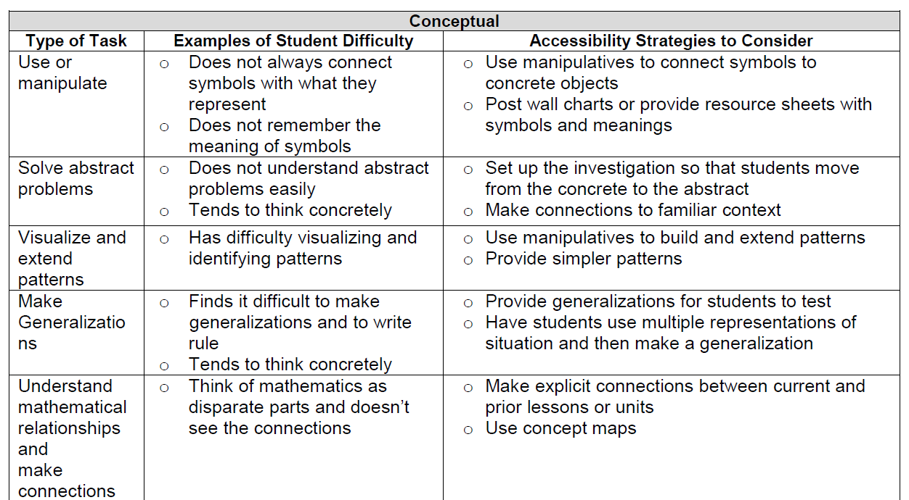
Accessibility Strategies
Make Generalizations
Notes:
Conceptual processing involves making connections among mathematical ideas, facts, and skills, and reflecting upon and refining one’s own understanding. Once students enter middle school, students begin to work with abstract concepts such as variables and linear functions, and make greater use of symbolic representations. Students who tend to think concretely may need additional support in order to move from concrete to abstract representations.
Within my role I am currently working with teachers to unpack contexts and conceptualize what a context is presenting and asking. I start by offering a word problem without the questions. Teachers then think about how to show the context with manipulatives. After conceptualizing with manipulatives, teachers create pictorial representations of the concrete thinking that they just engaged with. As a team, we share different representations and evaluate each for questions or clarity. Then connections are made between the different representations - for example, observations may include that all representations used base ten block models, but how the numbers within the context were decomposed differently. Once the representations are shared, the teachers go back and connect their original thinking to the procedural pathway for solving the problem. Engaging teachers in this work has helped them begin to understand how important conceptual processing is for ALL students. This type of activity conceptual processing is important to do with students as well so that they can see how their thinking connects between manipulatives, pictorial representations and the abstract numbers and symbols.

Slide 32
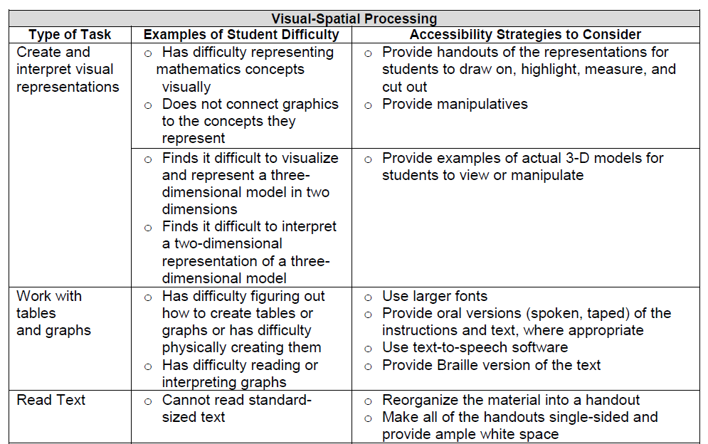
Accessibility Strategies
Notes:
I’m sure that all of you have given your students a word problem, only to have the students look it over and push it away exclaiming “I don’t get it”.... in this case, many times they look for the solution within the numbers and often rely on the key words. If students were able to “act out” the context with manipulatives, it would help them see how the actions can be connected to representations and eventually to abstract symbols.
Representing mathematical ideas is key to understanding mathematics. Some difficulties with such tasks are caused by a breakdown in the processing of visual information. If we think back to the first grade sample at the beginning of this webinar who was drawing circles as individual entities. His or her work with the 5+5+6, the 5 circles were represented in two groups side by side. A way to begin moving this learning forward is to model representing of the 5 and 5 on a ten frame, for example, so he would be able to “see” the ten-ness inherent within that, connecting this representation to the equation 5+5 = 10 and begin to understand and make sense of unitizing. Strengthening that visual representation for that student would lead him from drawing all the circles and then counting all, to the more efficient strategy of counting on from 10 and ultimately to composing tens facts, which are both at that first grade expectation.

Slide 33
Support for ELLs
A Framework for Re-envisioning Mathematics Instruction for English Language Learners, Council of the Great City Schools, December 2016
Employing Rigorous Tasks and Assignments
Encouraging Productive Struggle
Employing Multiple Modes and Representations in Mathematics
Supporting Academic Language and Conversations
Using Strategic Scaffolding
Notes:
We often get questions about strategies for ELLs and have found the resource shared here to have some concrete strategies for classroom use.
To begin, tasks and assignments for ELLs and all math learners should be at a high level of cognitive demand, mathematically rigorous, on grade level, and make explicit connections between new and prior concepts. Teachers should ensure that ELLs have the opportunity to engage in productive struggle, allowing them sufficient time to make sense of a task or problem before intervening. ELLs—as well as all math learners—should be in classroom environments that make ample use of multiple modes of communication (speaking, listening, reading, writing), multiple representations (pictures, diagrams, tables, graphs, visual displays), and multiple communication settings (BRIDGING) (working with a peer, in small groups, making presentations, sharing written explanations, and critiquing the reasoning of others.) that allow students to express their mathematical reasoning, describe their solutions to problems, and develop understanding of mathematical concepts. Classroom instruction should also facilitate academic discussions focused on mathematical ideas and support exploratory and explanatory talk and writing (ALLOWING and strengthening the move from conversational to academic language). Finally, and only when necessary, teachers should strategically employ scaffolds specifically targeted to meet an individual student’s educational needs or academic difficulties, while ensuring that this scaffolding does not compromise their access to rigorous mathematics content or their development of higher order conceptual understanding. (p. 10 of article)
Each of these key areas of instructional practice is considered in detail its own section in the document.

Slide 34
Supporting Academic Language and Vocabulary
Context: Is the context culturally relevant? Is the context familiar or new? Can the context be reused?
Content: Is the math vocabulary familiar or new? Does the vocabulary have multiple meanings?
Bay-Williams, Jennifer M. and Livers, Stefanie, “Supporting Math Vocabulary Acquisition,” 2009, NCTM, Teaching Children Mathematics
Different use in everyday language | table, row, right, bar, odd, mean, figure
Related but not as specific use in everyday language | similar, area, multiply, difference, base, cube
A homonym but not used in everyday language | sum/some, hour/our, plain/plane, ad/add, rose/rows
Different meaning from the word that translates from a student’s native language | figure/la figura (tables and graphs, but not numerals)
Notes:
Specifically around supporting language development, you can start with the context/content strategy.
When working through tasks, investigations and stories with students in class, ask yourself the above questions about the context. There may be context support needed, examples shown, vocabulary preview or review.
After context consider content. Now determine how and when to provide content support, specific to language. The table shows some language considerations on the left and examples on the right.
It is important to examine vocabulary carefully within math class. considering the following four areas outlined by Jennifer Bay-Williams, from University of Louisville.
In the article, by Jennifer Bay-Williams, from University of Louisville, there are also additional menu activities provided as an appendix.

Slide 35
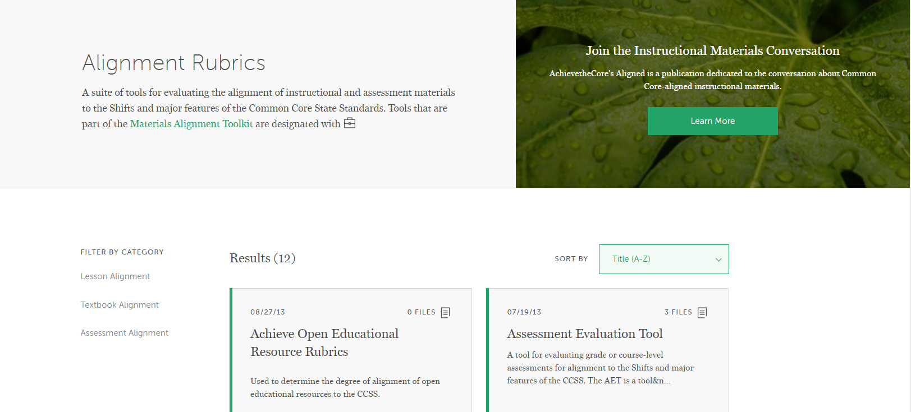
Alignment Resources
Notes:
On achievethecore we have many resources that can support you as you, your school and your district think about how to provide appropriate resources for all students and teachers. The Assessment Evaluation Tool (or AET) is a rubric you can use to evaluate your current assessment system or if your district is purchasing something to use as a universal screener. You want an assessment that gives you accurate diagnostic information on the content that matters most. This tool has specific indicators to help evaluate materials along those lines.
Here you’ll also find the Instruction Materials Evaluation Tool (or IMET), meant to be used as a rubric to review new or existing materials. This is important since we want instruction and materials to focus on the content that matters most. It’s easy to get side tracked by the bells and whistles that some programs offer for intervention, ELLs and struggling learners. Those extras won’t mean much though if the program is not spending the majority of time on the major work of the grade.

Slide 36
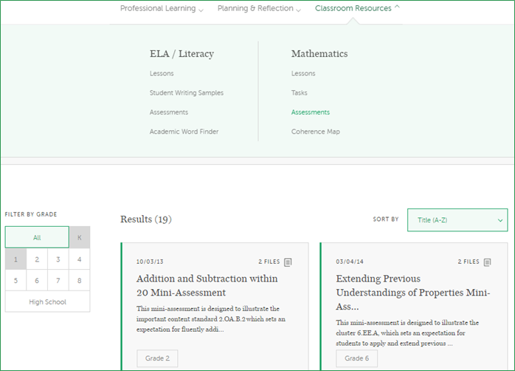
SAP mini-assessments
Notes:
If you are looking for some good mini-assessments, additional problems or tasks to use in small or whole group, check out the classroom resources tab on atc.

Slide 37
Additional Resources
IES Practice Guides, What Works Clearinghouse
Assisting Students Struggling with Mathematics: Response to Intervention (RtI) for Elementary and Middle Schools, 2009
Developing Effective Fractions Instruction for Kindergarten Through 8th Grade, 2010
Improving Mathematical Problem Solving in Grades 4 Through 8, 2012
Council of the Great City Schools
Common Core State Standards and Diverse Urban Students: Using Multi-Tiered Systems of Support, 2012

Slide 38
Question:
What additional resources have you found helpful in supporting students who struggle in mathematics?
Please use the Questions tab on your control panel to respond.

Slide 39
Your Questions

Slide 40
Tell us about your successes
www.achievethecore.org/educators-taking-action

Slide 41
Side Note…
Student Achievement Partners will be at the NCTM Annual Conference in San Antonio, April 5-8!
Will you? Let us know!
https://goo.gl/forms/TR39tA3KN9xWhK2j2

Slide 42
Please join us again next month!
Next month’s webinar: Building Fluent Readers
Wednesday, April 5, 2017
Register Here: https://attendee.gotowebinar.com/register/195895967247930113

Slide 43
Thank You!

